Slide 1
Predicting IMDb Score

Slide 2

Introduction
IMDb is an Internet Movie Database of all information related to movies, television programs and other media and entertainment
1
2
The movie ratings on the IMDb website gives a measure of goodness/quality of movies based on user votes
3
The votes from the registered users of IMDb website are weighted based on their profile
4
We implement supervised learning techniques to predict the IMDb score for a movie and also identify factors that contribute to a movie’s success
5
The business objective is to help the investors of a movie optimize their investment and reap good return on investment (ROI)

Slide 3
Business Problem and Solution
Business Problem
Desired Solution
Lack of definitive parameters to assess a movie’s success before its release
Identify significant factors that contribute to a movie’s commercial success
Quality of a movie is heavily depended on critic’s reviews which can be biased and time consuming
Need for a quality index to gauge a movie’s commercial success before its release

Slide 4



About IMDb Data
Data Source
IMDb dataset was obtained from Kaggle.com
Data Description
Dataset has 5043 rows and 28 columns
15 interval variables, 13 nominal and 1 binary variable
Mean value of target variable 6.4
Movie release year was in the range of 1916 - 2016
Target Variable
IMDb score is the target Variable
Interval data between the range of 1.0 and 10.0

Slide 5
Data Pre- Processing
Following steps were taken to clean the data before modeling:
Data De-duping
1% of the data was removed due to movies being repeated in the same year.
Cleaning Extraneous Data
Dataset contained special characters like Â and © in various columns.
Missing Value Treatment
19/28 variables had missing values.
Median values were imputed to these.
Outlier Treatment
Aspect Ratio had outlier values.
2% of the data was removed.

Slide 6
Data Pre- Processing Contd.
Variable Transformation
Log transformation was applied to positively skewed variables.
Optimal binning was used for “Facebook Likes” columns.
Variable Selection
Unwanted variables were removed.
Director name , actor names were removed since they have more than 2000 levels.
Variable Addition
External variables such as director and actor nominations were added.
Variable Binning
Color , language and Country was binned.

Slide 7
Data Pre- Processing Contd.
Dataset Size through Pre-processing
Variable Count through Pre-processing
Original Dataset
Original Dataset
28 Variables
5043 Rows
Data Deduping
4916 Rows (~1%)
Variable Selection
23 Variables
Outlier Treatment
4852 Rows
(~2%)
Genre Categorization
28 Variables

Slide 8
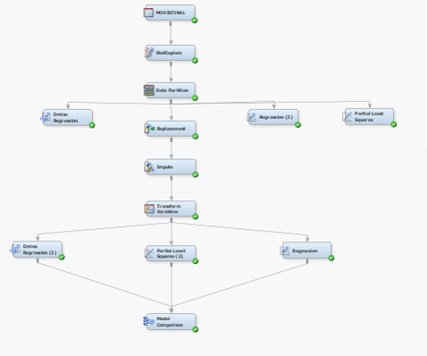
Process Flow Diagram
The DMINE procedure enables to quickly identify the input variables that are useful for predicting the target variable based on a linear models framework
Partial Linear squares(PLS) method finds the linear relation between the variables by projecting the target and predictor variables to a new space
Linear regression is a statistical method used to summarize the linear relation between the continuous variables

Slide 9
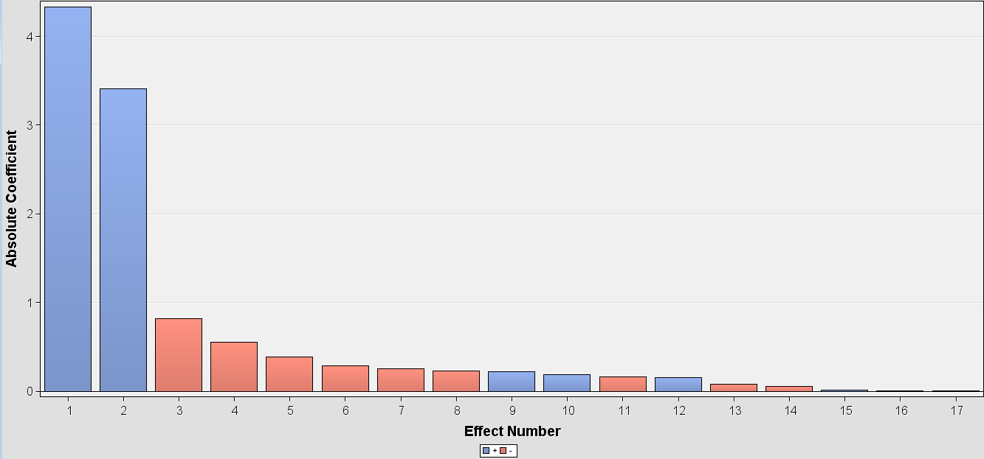
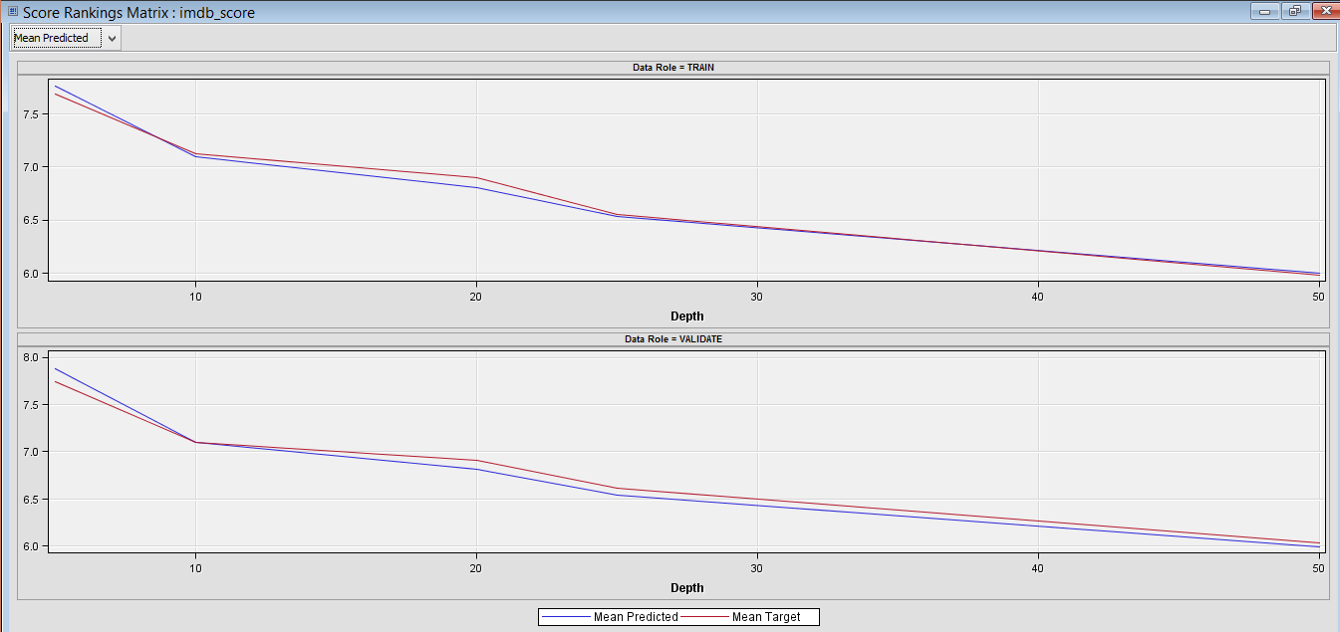
Linear Regression
R - square value 47%
Imputation and variable transformation has reduced the root mean square error by 4%
Adventure Genre, Country and Crime Genre are seen as the most significant variables in the Regression model

Slide 10
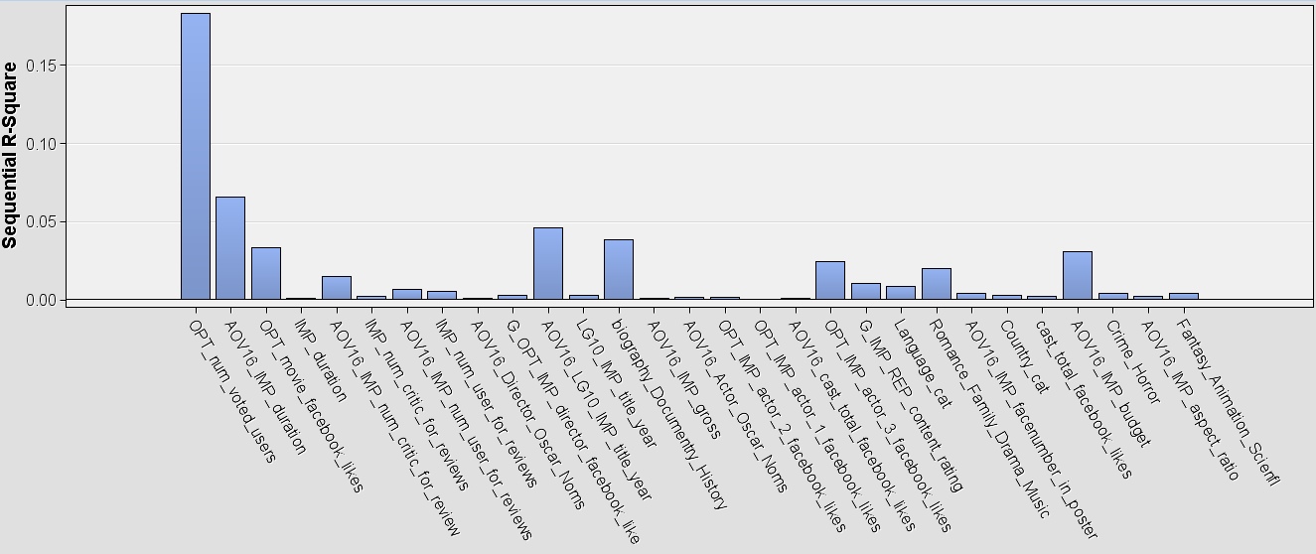
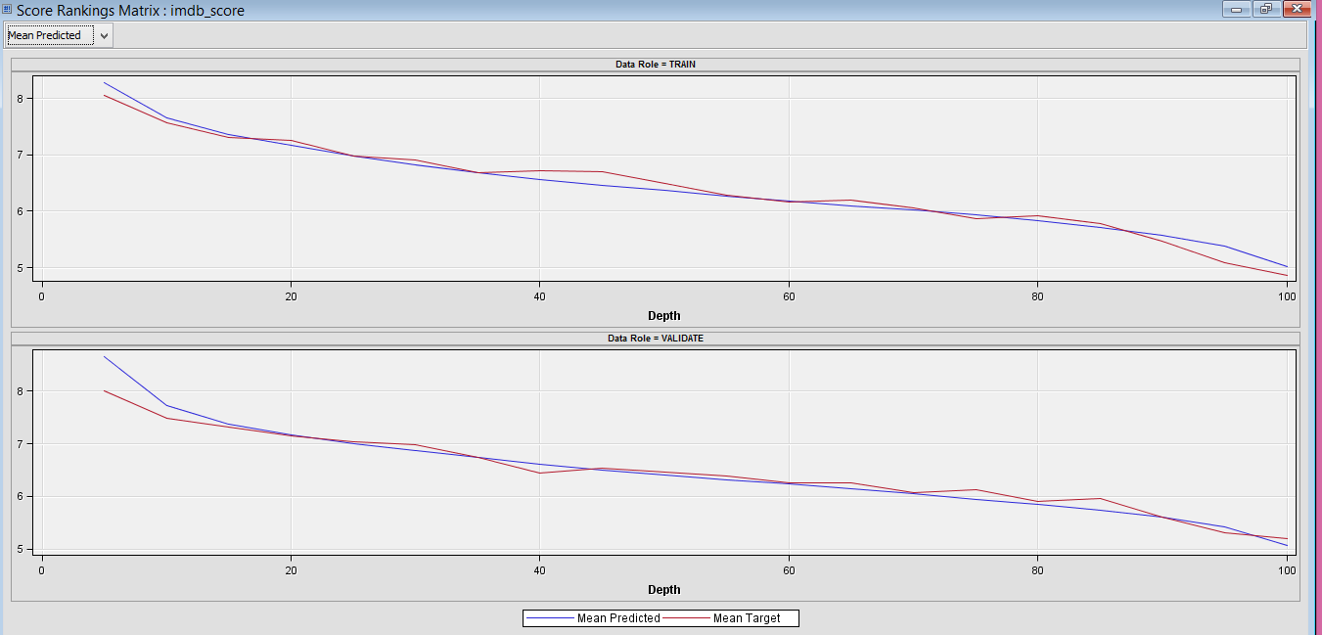
Dmine Regression
R- square value 51%
Transformation and imputation has reduced the root mean square error by 4%
Number of voted user, Facebook likes and movie duration are seen to have the most significant impact in Dmine Regression

Slide 11
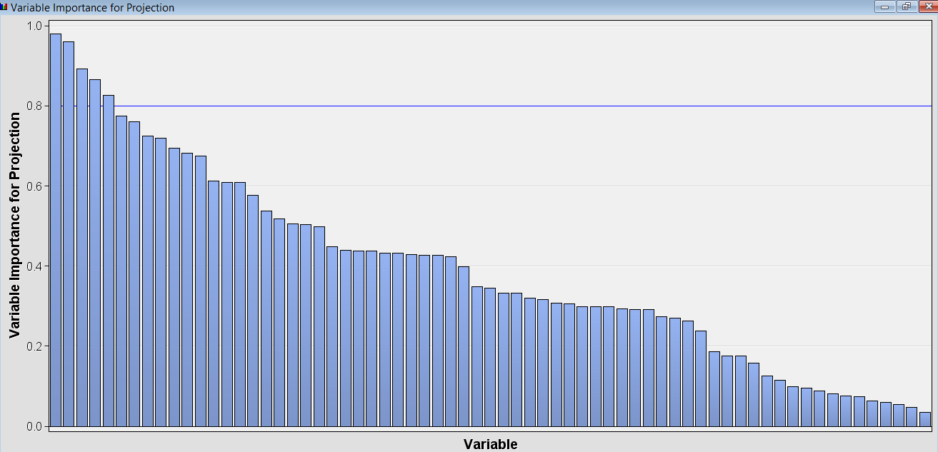
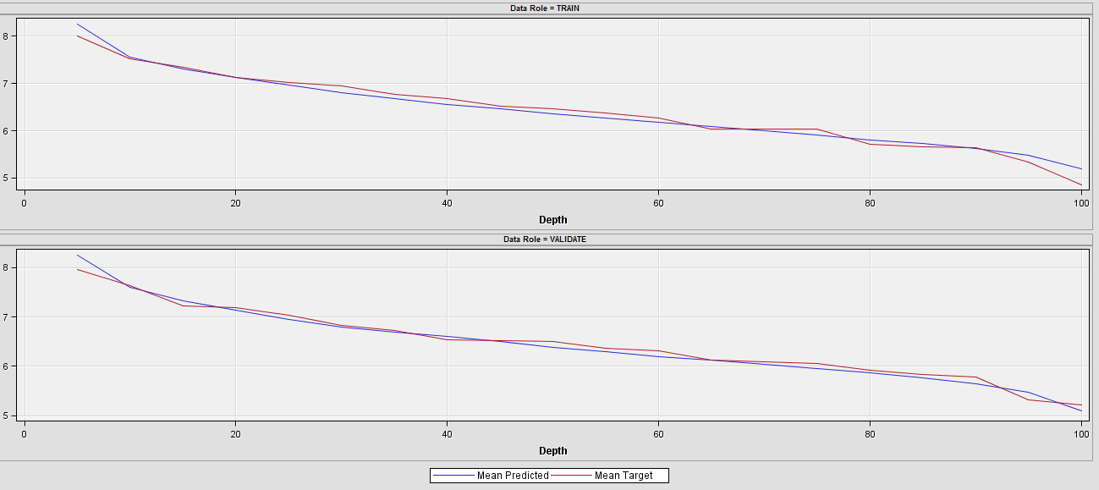
Partial Least squares
After performing variable imputation and transformation the root mean square error for the model reduced by 2%.
Number of voted user, Movie duration and Number of critic views are seen to have the most significant impact in PLS method

Slide 12
Model Comparison
 | Root Squared Error(Validation) | Root Squared Error (Train) | R² | Maximum Absolute Error
Dmine Regression | 0.709037 | 0.620161 | 51% | 5.490793
PLS | 0.734712 | 0.696726 | 47% | 5.534273 .
Regression | 0.911103 | 0.945726 |  | 5.753602

Slide 13
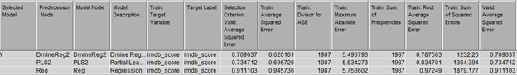
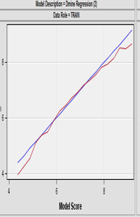
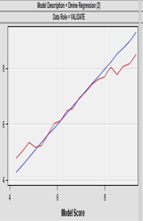
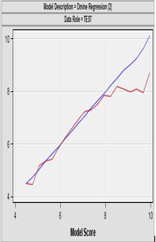
Model Selection
Dmine Regression was chosen as the best model for prediction
Score distribution of IMDb for Dmine Regression

Slide 14
Model Selection
•Dmine was selected as the best model by SAS E-Miner.
•Dmine has the lowest average squared error for validation data.
•R square value for the Dmine Regression model is 51%
•R value is the coefficient of determination.

Slide 15
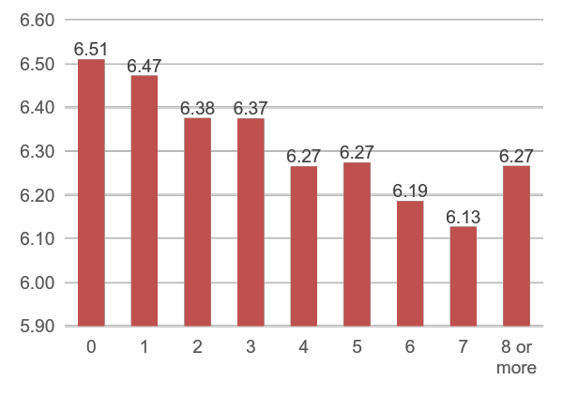
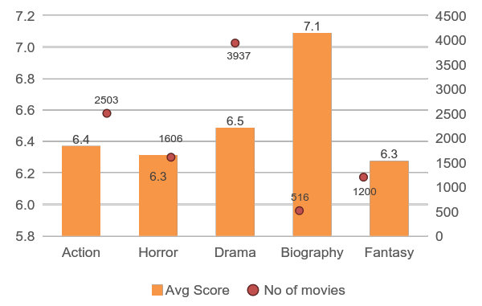
BUSINESS INSIGHTS
Face Number in Posters
Genre Vs IMDb Score
IMDb Scores
IMDb Scores
Genre
Face number in posters
Movies with high faces in poster earn a low IMDb score
Biography genre has high IMDb scores though less movies are released

Slide 16
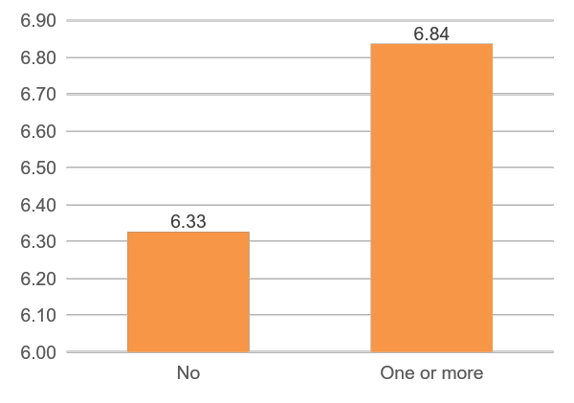
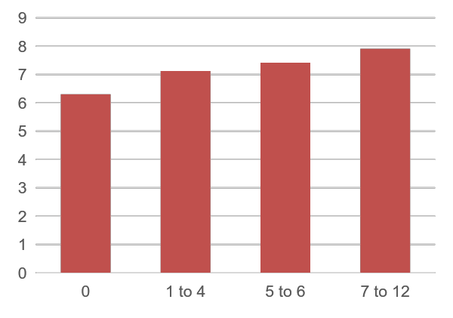
BUSINESS INSIGHTS
Actor Oscar Nominations
Director Oscar Nominations
IMDb Scores
IMDb Scores
Director Oscar Nominations
Actor Oscar Nominations
Directors who are nominated for more Oscars score high IMDb scores
Actors who are nominated for Oscars earn high IMDb scores

Slide 17
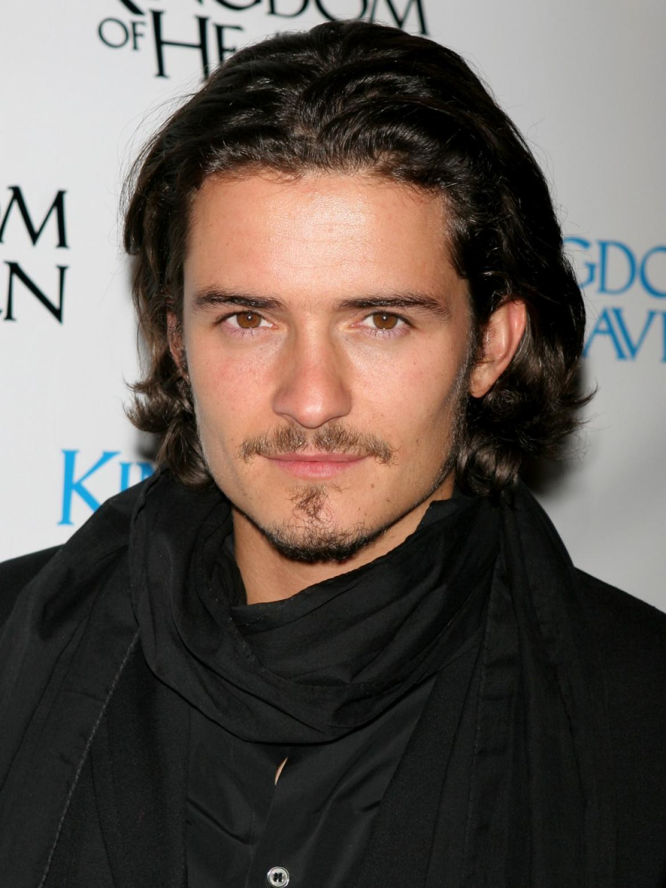
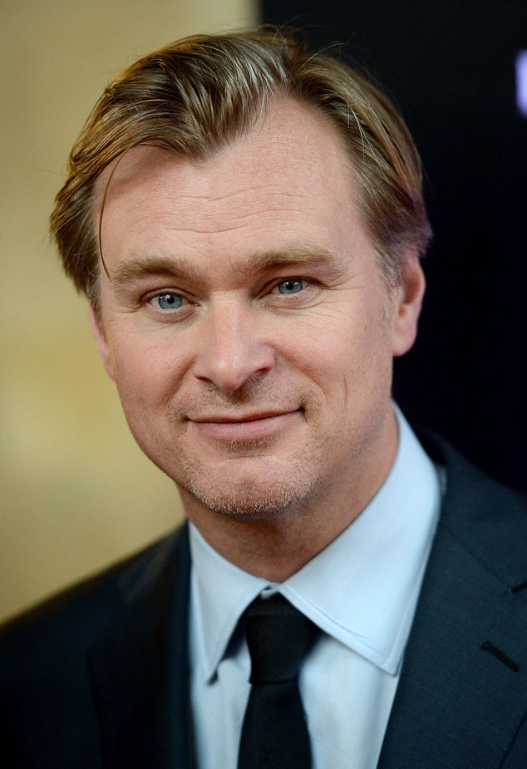

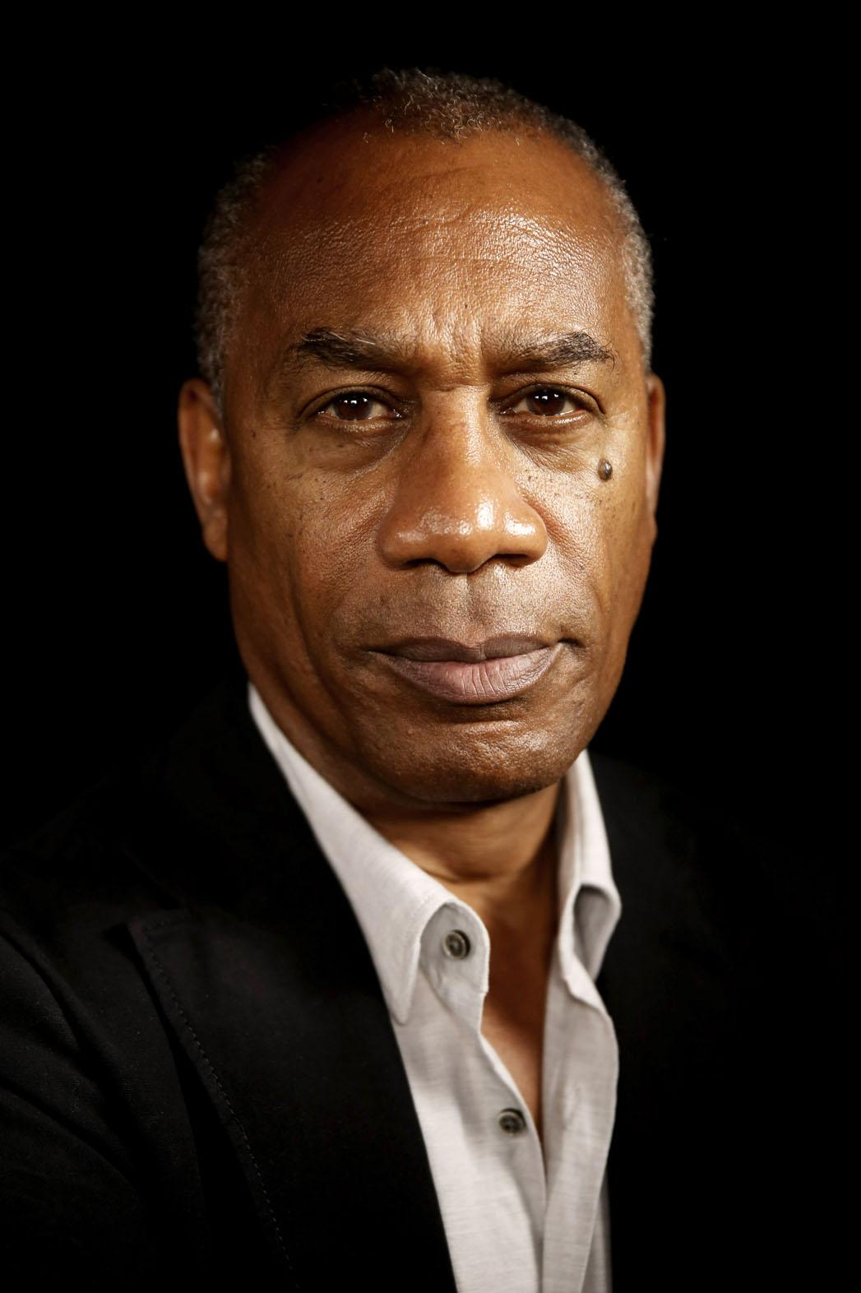
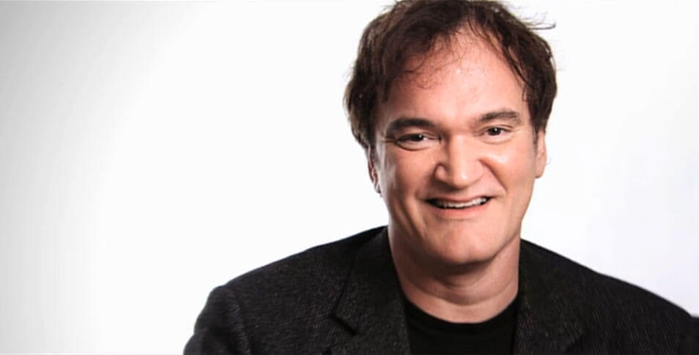

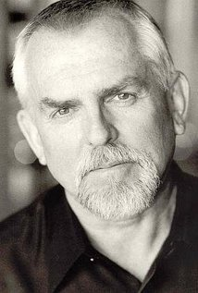
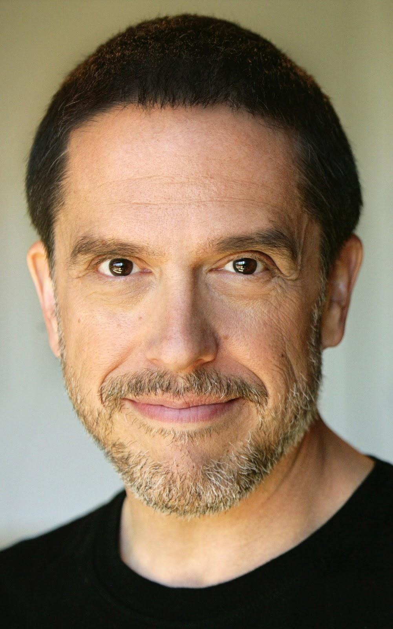

Best Actor - Director
Top Actors
Top Directors
Top Directors and Actor Combo
Christopher Nolan
Christopher Nolan
Orlando Bloom
Leonardo DiCaprio
8.9
8.64
8.8
Joe Morton
Quentin Tarantino
Christopher Nolan
Christian Bale
8.5
8.5
8.65
John Ratzenberger
Lee Unkrich
Christopher Nolan
Mathew McConaughey
8.35
8.3
8.6

Slide 18
Thank You
Questions?

Slide 19
APPENDIX

Slide 20
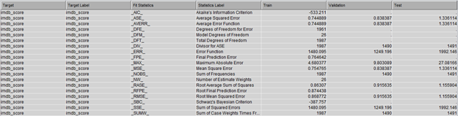
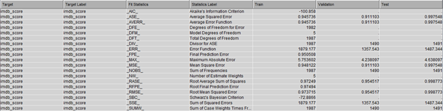
Stepwise Linear Regression result before and after imputing
Before Imputation and Transformation
After Imputation and Transformation

Slide 21
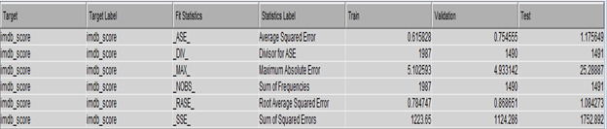
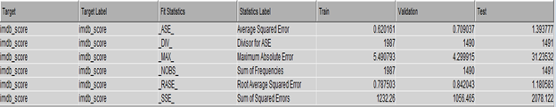
D-Mine Regression result before and after imputing
Before Imputation and Transformation
After Imputation and Transformation

Slide 22
Partial Least Squares result before and after imputing
Before Imputation and Transformation
After Imputation and Transformation

